Slide 1

Operating systems
Storage Management
Venkatesh Prasad
Department of Computer Science

Slide 2
Operating systems
Implementing File-Systems
Venkatesh Prasad
Department of Computer Science
Notes:
To describe the details of implementing local file systems and directory structures
To describe the implementation of remote file systems
To discuss block allocation and free-block algorithms and trade-offs

Slide 3
OPERATING SYSTEMS
Slides Credits for all PPTs of this course
The slides/diagrams in this course are an adaptation, combination, and enhancement of material from the following resources and persons:
Slides of Operating System Concepts, Abraham Silberschatz, Peter Baer Galvin, Greg Gagne - 9th edition 2013 and some slides from 10th edition 2018
Some conceptual text and diagram from Operating Systems - Internals and Design Principles, William Stallings, 9th edition 2018
Some presentation transcripts from A. Frank – P. Weisberg
Some conceptual text from Operating Systems: Three Easy Pieces, Remzi Arpaci-Dusseau, Andrea Arpaci Dusseau

Slide 4
OPERATING SYSTEMS
File-System Structure
File structure
Logical storage unit
Collection of related information
File system resides on secondary storage (disks)
Provided user interface to storage, mapping logical to physical
Provides efficient and convenient access to disk by allowing data to be stored, located retrieved easily
Disk provides in-place rewrite and random access
I/O transfers performed in blocks of sectors (usually 512 bytes)
File control block (FCB) – storage structure consisting of information about a file including ownership, permissions, and location of the file contents
Device driver controls the physical device
File system organized into layers

Slide 5
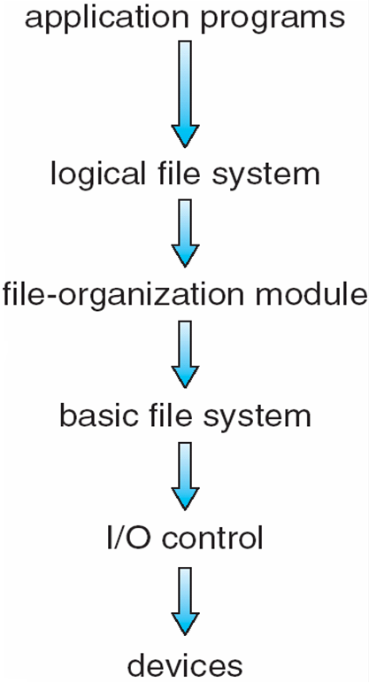
OPERATING SYSTEMS
Layered File System
Manages metadata information, and the dir structure to provide the file-org module. Also responsible for protection
Translates logical to physical block addresses
Issues generic commands to the device driver, manages mem buffers
Device drivers and interrupt handlers
Notes:
The file system is generally composed of many different levels

Slide 6
OPERATING SYSTEMS
File System Layers
Device drivers manage I/O devices at the I/O control layer
Given commands like “read drive1, cylinder 72, track 2, sector 10, into memory location 1060” outputs low-level hardware specific commands to hardware controller
Basic file system given command like “retrieve block 123” translates to device driver
Also manages memory buffers and caches (allocation, freeing, replacement)
Buffers hold data in transit
Caches hold frequently used data

Slide 7
OPERATING SYSTEMS
File System Layers (Cont.)
File organization module understands files, logical address, and physical blocks
Translates logical block # to physical block #
Manages free space, disk allocation
Logical file system manages metadata information
Translates file name into file number, file handle, location by maintaining file control blocks (inodes in UNIX)
Directory management
Protection

Slide 8
OPERATING SYSTEMS
File System Layers (Cont.)
Layering useful for reducing complexity and redundancy, but adds overhead and can decrease performance.
Logical layers can be implemented by any coding method according to OS designer
Many file systems, sometimes many within an operating system
Each with its own format (CD-ROM is ISO 9660; Unix has UFS, FFS; Windows has FAT, FAT32, NTFS as well as floppy, CD, DVD Blu-ray, Linux has more than 40 types, with extended file system ext2 and ext3 leading; plus distributed file systems, etc.)
New ones – ZFS, GoogleFS, Oracle ASM, FUSE
Notes:
FUSE – File System in User Space
On Linux, execute any of these commands to find the type of file system used on your system
Cat /etc/fstab
lsblk –f
df -Th
sudo file –s /dev/xyz where xyz is the device name such as sda1, sda5, sda6, etc

Slide 9
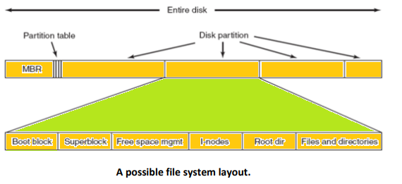
OPERATING SYSTEMS
File-System Implementation

Slide 10
OPERATING SYSTEMS
File-System Implementation
We have system calls at the API level, but how do we implement their functions?
On-disk and in-memory structures
Boot control block contains info needed by system to boot OS from that volume
Needed if volume contains OS, usually first block of volume
Volume control block (superblock, master file table) contains volume details
Total # of blocks, # of free blocks, block size, free block pointers or array
Directory structure organizes the files
Names and inode numbers, master file table
Notes:
A superblock is a record of the characteristics of a filesystem, including its size, the block size, the empty and the filled blocks and their respective counts, the size and location of the inode tables, the disk block map and usage information, and the size of the block groups.

Slide 11
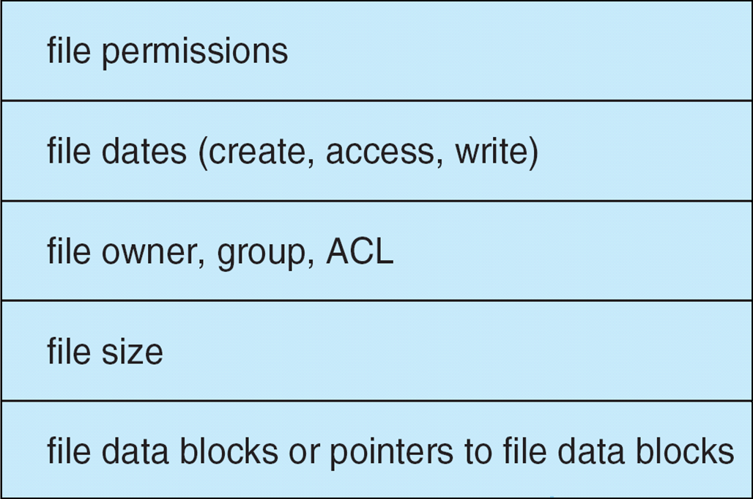
OPERATING SYSTEMS
File-System Implementation (Cont.)
Per-file File Control Block (FCB) contains many details about the file
inode number, permissions, size, dates
NFTS stores into in master file table using relational DB structures

Slide 12
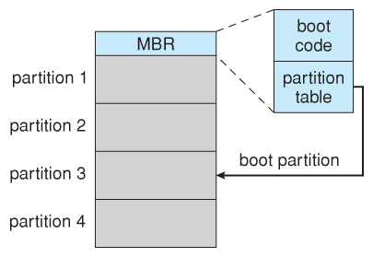
OPERATING SYSTEMS
Boot Block
Computer ROM contains a bootstrap program ( OS independent ) with just enough code to find the first sector on the first hard drive on the first controller, load that sector into memory, and transfer control over to it
Master Boot Record, MBR, is the first sector on the hard drive
contains a very small amount of code in addition to the partition table.
The partition table documents how the disk is partitioned into logical disks, and indicates specifically which partition is the active or boot partition.
The boot program then looks to the active partition to find an operating system
In a dual-boot ( or larger multi-boot ) system, the user may be given a choice of which os to boot, with a default action to be taken in the event of no response within some time frame.
Once the kernel is found by the boot program, it is loaded into memory and then control is transferred over to the OS.
Kernel will start important services
Boot options at this stage may include single-user a.k.a. maintenance or safe modes, in which very few system services are started.
Booting from disk in Windows.

Slide 13
OPERATING SYSTEMS
In-Memory File System Structures
Mount table storing file system mounts, mount points, file system types
The following figure illustrates the necessary file system structures provided by the operating systems
Figure (a) refers to opening a file
Figure (b) refers to reading a file
Plus buffers hold data blocks from secondary storage
Open returns a file handle for subsequent use
Data from read eventually copied to specified user process memory address

Slide 14
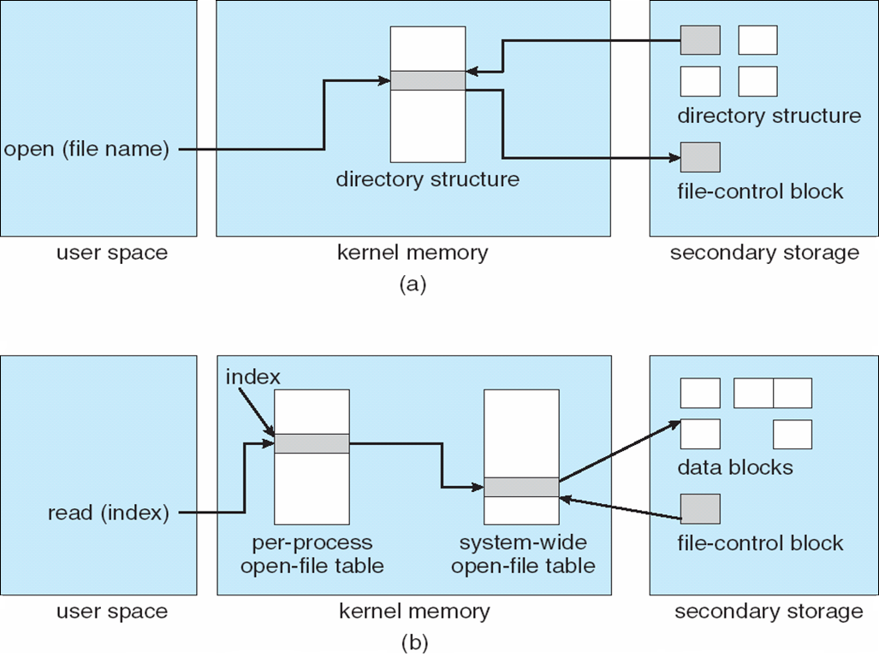
OPERATING SYSTEMS
In-Memory File System Structures

Slide 15
OPERATING SYSTEMS
Partitions and Mounting
Partition can be a volume containing a file system (“cooked”) or raw – just a sequence of blocks with no file system
Boot block can point to boot volume or boot loader set of blocks that contain enough code to know how to load the kernel from the file system
Or a boot management program for multi-os booting
Root partition contains the OS, other partitions can hold other OS’s, other file systems, or be raw
Mounted at boot time
Other partitions can mount automatically or manually
At mount time, file system consistency checked
Is all metadata correct?
If not, fix it, try again
If yes, add to mount table, allow access

Slide 16
OPERATING SYSTEMS
Virtual File Systems
Virtual File Systems (VFS) on Unix provide an object-oriented way of implementing file systems
VFS allows the same system call interface (the API) to be used for different types of file systems
Separates file-system generic operations from implementation details
Implementation can be one of many file systems types, or network file system
Implements vnodes which hold inodes or network file details
Then dispatches operation to appropriate file system implementation routines

Slide 17
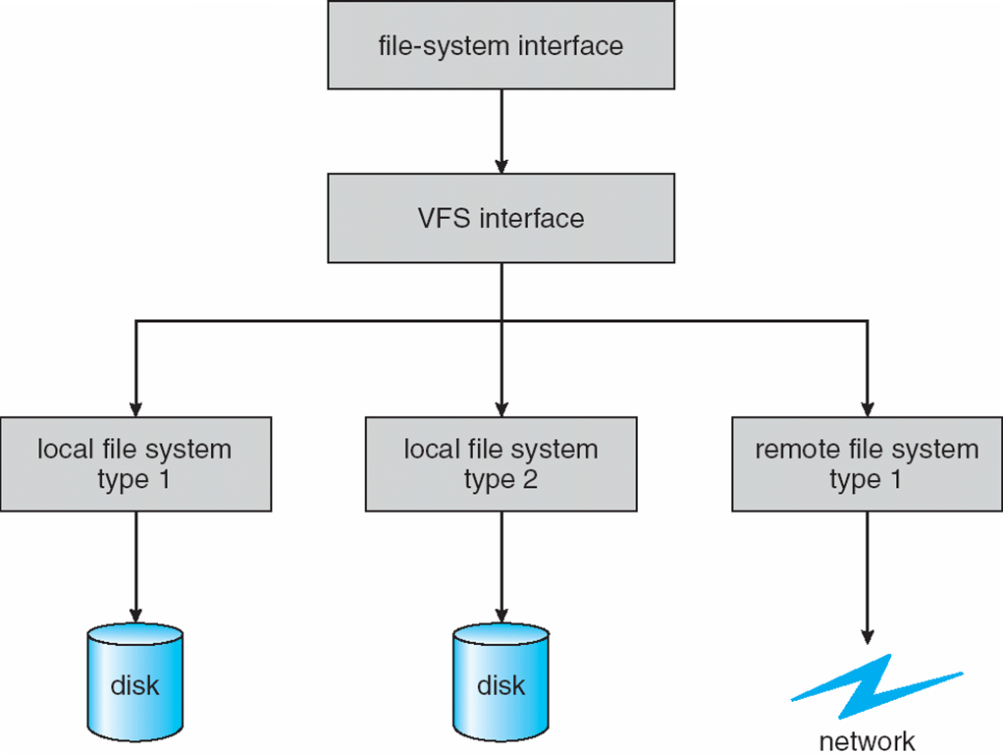
OPERATING SYSTEMS
Virtual File Systems
The API is to the VFS interface, rather than any specific type of file system (FS)
VFS provides a single set of commands for the kernel and developers to access all types of FSs
VFS software calls the specific device driver required to interface to various types of FSs
Device driver interprets the standard set of FS commands to a specific type of FS on the partition or logical volume

Slide 18
OPERATING SYSTEMS
Virtual File Systems
For example, Linux has four object types:
Inode object, file object, superblock object, dentry object
VFS defines set of operations on the objects that must be implemented
Every object has a pointer to a function table
Function table has addresses of routines to implement that function on that object
For example:
• int open(. . .)—Open a file
• int close(. . .)—Close an already-open file
• ssize t read(. . .)—Read from a file
• ssize t write(. . .)—Write to a file
• int mmap(. . .)—Memory-map a file
Notes:
Inode object structure represents an individual file
File object represents an open file
Superblock object represents entire file system
Dentry object represents an individual dir entry

Slide 19

THANK YOU
Venkatesh Prasad
Department of Computer Science Engineering
venkateshprasad@pes.edu

